Slide 1



TITLE :
BATCH NO : 01
Pox Disease Identification Using Deep Learning
GUIDED BY: Dr.S.KALAISELVI
Team Members:
ARAVIND KANNA V(22BSR001)
GUGAN R S(22BSR017)
NADISH G Y(22BSR033)

Slide 2
Table of Contents:
Abstract
Objective of the research
Dataset description
Literature Review
Methodologies used
Evaluation metrics
Conclusion
Future Work

Slide 3
Abstract:
Pox diseases, caused by viruses, pose significant health, economic, and agricultural challenges by affecting humans, animals, and plants.
Pox diseases, such as chickenpox, cowpox, and monkeypox, pose significant health risks and require accurate and timely identification for effective management.
This research leverages deep learning techniques to develop a robust system for identifying pox diseases from image datasets.
The study utilizes a well-structured dataset consisting of training, validation, and testing images categorized into four classes: chickenpox, cowpox, monkeypox, and healthy.

Slide 4
Objective of the Research:
The main objective of this research is to create a deep learning-based system that can automatically identify pox diseases like chickenpox, cowpox, and monkeypox from images.
By using a well-organized dataset, the system will be trained to classify images into four categories: chickenpox, cowpox, monkeypox, and healthy.
This research aims to make disease detection faster, more accurate, and easier for healthcare professionals, helping to detect and manage these diseases early.

Slide 5
Dataset Description:
The dataset used in this research is sourced from Kaggle and consists of images organized into four categories: chickenpox, cowpox, monkeypox, and healthy skin.
It is divided into three distinct sets: a training set with 8,000 images, a test set with 103 images, and a validation set with 2,004 images.
The images in the dataset are intended to train and evaluate deep learning models for the automated identification of these diseases.
The dataset provides a balanced set of examples for each category, making it suitable for training a model to distinguish between pox diseases and healthy skin.

Slide 6
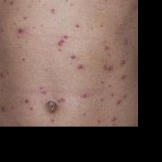
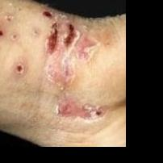
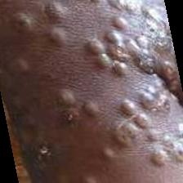
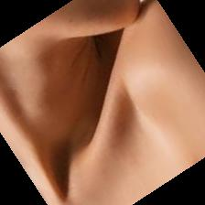
https://www.kaggle.com/datasets/dinesh873/poxdata
Chicken Pox
Cow Pox
Monkey Pox
Healthy

Slide 7
Literature Review:
TITLE | AUTHOR | YEAR | ALGORITHM USED AND RESULT
Computer-Aided Detection and Classification of Monkeypox and Chickenpox Lesion in Human Subjects Using Deep Learning Framework | Dilber Uzun Ozsahin, Mubarak Taiwo Mustapha, Berna Uzun, Basil Duwa, Ilker Ozsahin | 2023 | Proposed CNN model - 99.60% AlexNet - 80% VGGNet - 80%
Deep and Transfer Learning Approaches for Automated Early Detection of Monkeypox (Mpox) Alongside Other Similar Skin Lesions and Their Classification | Madhumita Pal et al. | 2023 | CNN - 93.43% VGG19 - 94.06% Inception v3 - 96.56% Autoencoder - 85.62%

Slide 8
Monkeypox Virus Detection Using Pre-trained Deep Learning-based Approaches | Chiranjibi Sitaula, Tej Bahadur Shahi | 2022 | Ensemble - 87.13% Xception - 85.40% DenseNet - 85.47%
Detection of Monkeypox Among Different Pox Diseases with Different Pre-Trained Deep Learning Models | Muhammed Çelik, Özkan İnik | 2023 | VGG - 78.82% EfficientNet - 75.88% MobileNet - 71.76% VGG - 71.35% GoogLeNet - 70.00%
Monkeypox Skin Lesion Detection Using Deep Learning Models: A Feasibility Study | Shams Nafisa Ali, Md. Tazuddin Ahmed, Joydip Paul, Tasnim Jahan, S. M. Sakeef Sani, Nawsabah Noor, Taufiq Hasan | 2022 | ResNet - 82.96% VGG - 81.48% Inception - 74.07%
Deep Learning Models for the Detection of Monkeypox Skin Lesion on Digital Skin Images | Othman A. Alrusaini | 2023 | VGG - 96% ResNet - 90% SqueezeNet - 86% Inception - 89% SVM - 90%

Slide 9
Methodologies used:
1. Convolutional Neural Network (CNN)
A CNN is a deep learning model specifically designed for image classification and computer vision tasks. It uses convolutional layers to extract features from images and fully connected layers for classification.
Architecture:
4 Convolutional layers (3×3 filters, ReLU activation)
Max-pooling layers (2×2)
2 Fully connected layers (Dense layers with ReLU)
Softmax output layer (for multi-class classification)

Slide 10
2.VGG
VGG defines the structure of a deep Convolutional Neural Network (CNN) with multiple layers of 3x3 convolutions, pooling layers, and fully connected layers.It specifies how many layers are used (e.g., 16 layers in VGG16 or 19 layers in VGG19) and how they are connected.
Architecture:
13 Convolutional layers (3×3 filters, ReLU activation)
5 Max-pooling layers (2×2)
Flatten layer
3 Fully connected layers (Dense layers, ReLU activation)
Softmax output layer

Slide 11
3. InceptionV3
InceptionV3 is a deep Convolutional Neural Network (CNN) architecture designed to improve computational efficiency and accuracy.It uses Inception modules with parallel convolutions (1x1, 3x3, and 5x5) to capture multi-scale features.It reduces parameters by factorizing convolutions and using global average pooling. Architecture:
Inception modules (1×1, 3×3, 5×5 filters combined)
Batch normalization
Auxiliary classifiers (helps in training)
Fully connected layers
Softmax output layer

Slide 12
4.NasNet
NASNet is a CNN architecture designed using Neural Architecture Search (NAS), an algorithm that automates the process of finding the best network architecture.The model consists of two types of cells: Normal Cell (feature extraction) and Reduction Cell (downsampling).It optimizes both accuracy and efficiency by learning the architecture from the dataset.
Architecture:
Normal and reduction cells for feature extraction
Factorized convolutions (1×1 and 3×3 filters)
Batch normalization
Global average pooling layer
Fully connected layers
Softmax output layer

Slide 13
5. DenseNet
DenseNet is a deep CNN architecture where each layer is connected to every other layer in a feed-forward manner. It uses Dense Blocks with short connections, which enhance feature propagation and reduce the vanishing gradient problem.This design enables efficient feature reuse and reduces the number of parameters compared to traditional CNNs.
Architecture:
Dense blocks with multiple convolutional layers (1×1 and 3×3 filters)
Transition layers (Batch normalization + pooling)
Global average pooling layer
Fully connected layers
Softmax output layer

Slide 14
Evaluation metrics:
MODEL NAME | ACCURACY | PRECISION | RECALL | F1-SCORE
CNN | 82.52 | 85.75 | 81.55 | 81.49
VGG | 81.55 | 86.98 | 81.55 | 81.22
InceptionV3 | 87.52 | 86.55 | 85.98 | 85.55
DenseNet | 92.23 | 93.75 | 92.23 | 92.36
NasNet | 89.32 | 95.65 | 93.75 | 97.77

Slide 15
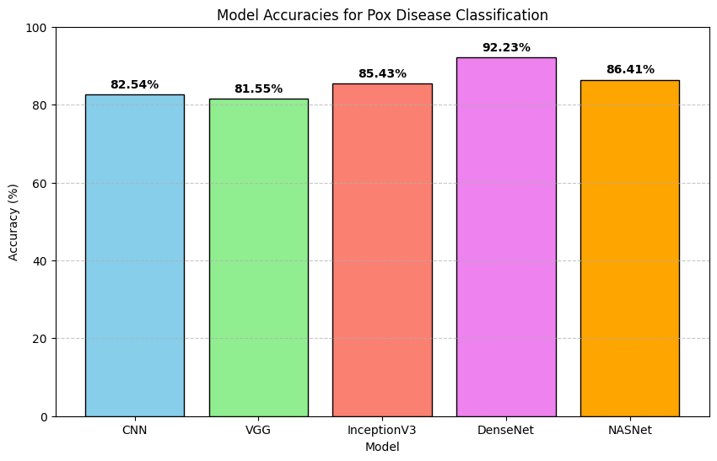
Comparison of Accuracy:

Slide 16
Conclusion:
In this study, various deep learning architectures—CNN, VGG, InceptionV3, DenseNet, and NASNet—were utilized to classify pox disease images into four categories: chickenpox, cowpox, monkeypox, and healthy.
Each model demonstrated unique strengths in feature extraction and classification performance. Among all the models, DenseNet provided the highest accuracy, showcasing its superior capability in feature propagation and reuse.
The overall results demonstrate the potential of advanced deep learning architectures in accurately distinguishing between the different categories of pox diseases.

Slide 17
Future Work:
Explore advanced models such as EfficientNet and Vision Transformers to enhance accuracy and robustness.
Apply transfer learning and fine-tuning on larger medical datasets to improve model performance.
Integrate explainable AI techniques like Grad-CAM for better interpretability of model predictions.
Develop a mobile or web application for real-time pox disease diagnosis and accessibility.
Collaborate with healthcare institutions for clinical validation to ensure real-world reliability.

Slide 18
Reference:
D. Uzun Ozsahin, M. T. Mustapha, B. Uzun, B. Duwa, and I. Ozsahin, "Computer-Aided Detection and Classification of Monkeypox and Chickenpox Lesion in Human Subjects Using Deep Learning Framework," Diagnostics, vol. 13, no. 292, pp. 1–14, Jan. 2023. DOI: 10.3390/diagnostics13020292.
M. Pal et al., "Deep and Transfer Learning Approaches for Automated Early Detection of Monkeypox (Mpox) Alongside Other Similar Skin Lesions and Their Classification," ACS Omega, vol. 8, no. 35, pp. 31747–31757, Aug. 2023. DOI: 10.1021/acsomega.3c02784.
C. Sitaula and T. B. Shahi, "Monkeypox Virus Detection Using Pre-trained Deep Learning-based Approaches," Journal of Medical Systems, vol. 46, no. 78, pp. 1–9, Oct. 2022. DOI: 10.1007/s10916-022-01868-2.

Slide 19
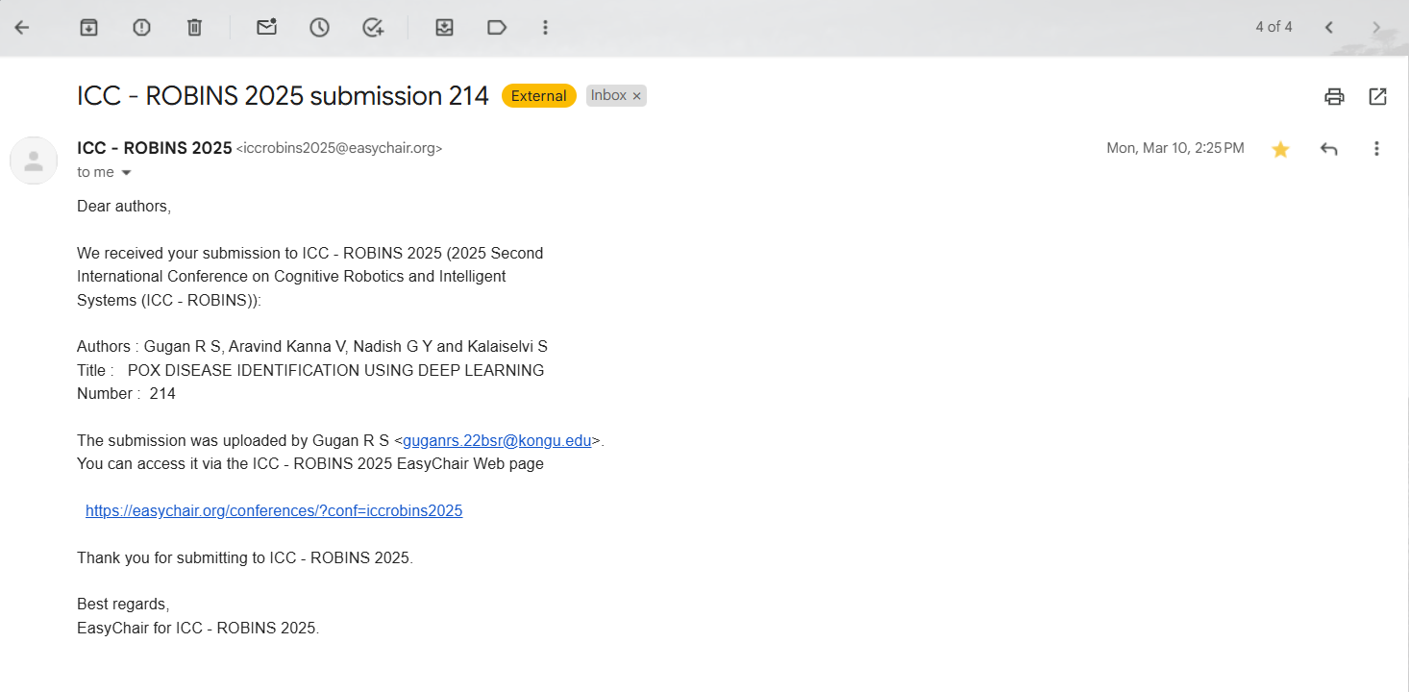
Paper Status:

Slide 20
Thank You !!

